Slide 1

Starter Task
Complete the SDD implementation starter task
Attempt both questions

Slide 2
Learning intentions and success criteria
I am learning…
I can…
About iteration and loops in software
How to write FOR, DO, and WHILE loops
Describe the two types of loops in SDD
Write programs using FOR, DO, and WHILE loops

Slide 3

Loops Loops Loops
N5 - Software Design & Development

Slide 4
Recap
Arithmetic operations are calculations that are performed within a program. They include arithmetic operators, such as:
Operator | Meaning | Example
+ | Plus | 2 + 4 = 6
- | Minus | 7 – 5 = 2
* | Multiply | 4 * 3 = 12
/ | Divide | 100 / 4 = 25
^ (sometimes **) | Exponent | 3 ^ 2 = 36 2 ** 8 = 256
An expression can also contain concatenation, which is when two or more strings are joined together.
Operator | Meaning | Example
& | Concatenate | “Fire” & “man” = “Fireman”

Slide 5
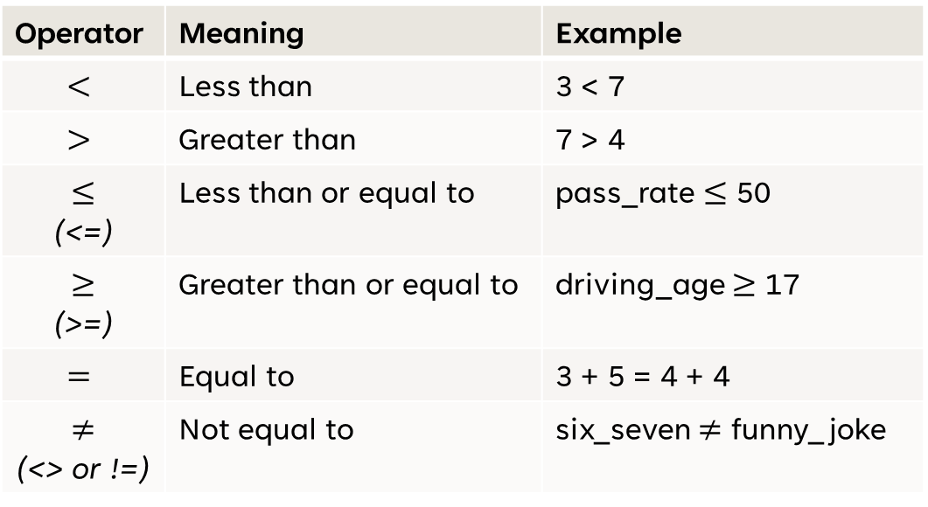
Recap
In conditions (“if” statements), you often use selection operators such as:
Operator | Meaning | Example
$$<$$ | Less than | 3 < 7
$$>$$ | Greater than | 7 > 4
$$≤$$ (<=) | Less than or equal to | pass_rate $≤$ 50
$$≥$$ (>=) | Greater than or equal to | driving_age $≥$ 17
$$=$$ | Equal to | 3 + 5 = 4 + 4
$$≠$$ (<> or !=) | Not equal to | six_seven $≠$ funny_joke

Slide 6
Recap - AND
Using AND, both the expressions must be TRUE for the expression to be TRUE:
IF score < 70 AND score >= 60 THEN
DISPLAY “You got a B!”
END IF
Score | Is the message displayed?
65% | Yes (Both conditions met)
32% | No (Only 2nd condition met)
87% | No (Only 1st condition met)
60% | Yes (Both conditions met)

Slide 7
Recap- OR
With OR, only ONE expression needs to be TRUE:
For example:
IF has_jacket = True OR is_raining = False THEN
DISPLAY “You can go outside”
END IF
Score | Can you go outside?
No jacket, not raining | Yes (2nd condition met)
Has jacket, not raining | Yes (Both conditions met)
No jacket, is raining | No (Neither conditions met)
Has jacket, is raining | Yes (1st condition met)

Slide 8
Recap - NOT
NOT inverts the expression and returns the opposite result:
For example:
IF NOT (age >= 18) THEN
DISPLAY “You are not an adult”
END IF
Sometimes, using NOT is more readable.

Slide 9
Iteration
Iteration is the process of repeating instructions in a program a desired number of times:
Iteration is achieved in programming using loops
Using loops in a program can drastically reduce the number of lines of code you have to type, improving efficiency
There are two types of loops:
Fixed loop – Repeats a fixed number of times
Conditional loop – Repeats until a condition is met

Slide 10
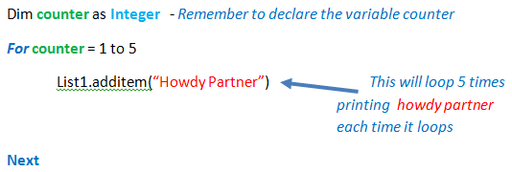
Fixed Loops (For)
This type of loop is known as a Fixed Loop because we know exactly how many times we want it to repeat our instructions:
A for-loop begins with FOR
A for-loop ends with NEXT

Slide 11
Fixed Loops (For)
When programming a loop, a new variable must be created that controls/ counts how many times the loop is executing:
We will call this the counter, but we can name this anything as it's just a variable
The counter needs to be declared as an Integer before you start the loop

Slide 12
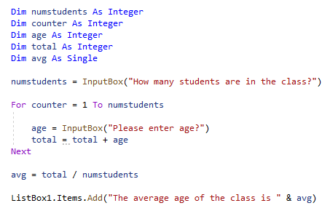
Fixed Loops (For)
A fixed loop can also be controlled by a variable meaning that the loop is set by user input.
The user decides how many times the program will loop
The program uses the numstudents variable

Slide 13
Fixed Loops Task

Slide 14
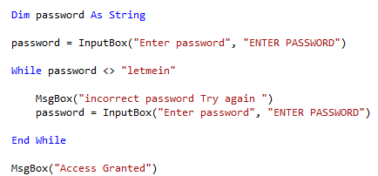
Conditional Loop (While)
This type of loop is known as a Conditional Loop because we will continue to loop over and over until a condition is met:
It will keep on looping until a valid input is entered.
A while-loop begins with WHILE and ends with END WHILE

Slide 15
Conditional Loop (While)
This loop will run forever WHILE the password is not equal to “letmein”:
The program keeps asking for a password while it is still incorrect

Slide 16
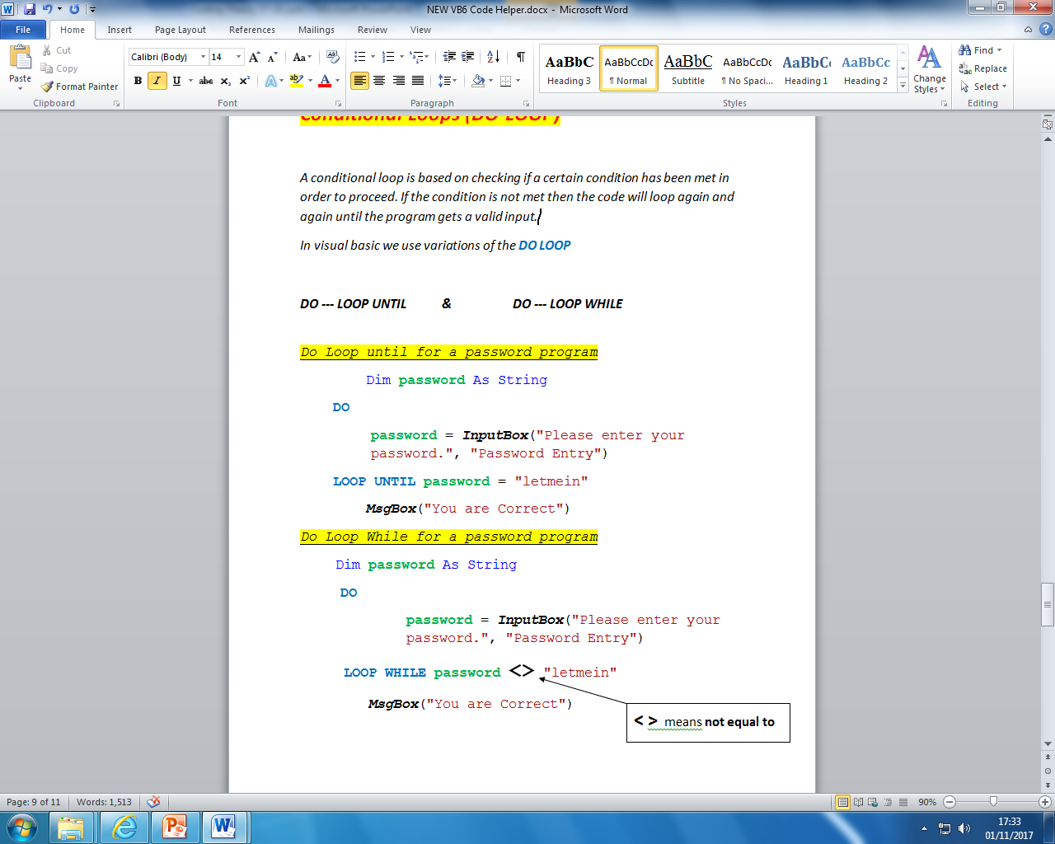
Conditional Loop (Do)
Another type of conditional loop you can do is a DO loop:
Works similar to a while loop – it will keep looping until a condition is met
A do-loop begins with DO and ends with LOOP UNTIL
Below is the same program but using a do-loop instead of a while-loop:

Slide 17
Do-loop vs. While-loop
DO loop:
WHILE loop:
With a do-loop you only ask ONCE
With a while-loop, you need to ask for user input TWICE

Slide 18
Do-loop vs. While-loop
DO loop:
WHILE loop:
With a while-loop, you keep looping while the condition is not met
With a do-loop you keep looping until the condition is met

Slide 19
Conditional Loops Task

Slide 20
Learning intentions and success criteria
I am learning…
I can…
About iteration and loops in software
How to write FOR, DO, and WHILE loops
Describe the two types of loops in SDD
Write programs using FOR, DO, and WHILE loops

